Slide 1
PILOT STUDENTS – Oct/Nov 2015 (this applies to you)
(1) When you see an instruction to upload something, upload it to your desktop. If faculty needs it, they will ask for it.
(2) Contact info is in the FAQ for any issues.
Intro to NoSQL - Module 4
Columnar Databases
Notes:
Note to Narrator: Do NOT narrate any words, acronyms, or anything enclosed in ( ) that’s in the narrative script.

Slide 2

Course Objectives
Here are some points that this course will cover:
An introduction to Columnar DBs and comparison with other data architectures
Value of Columnar DBs
A vendor tour of Cassandra and how it is used in the industry
A vendor tour of HBase and how it is used in the industry
Accenture use cases of afore mentioned vendors
Challenges and limitations of technology
Notes:
Narrative:

Slide 3
This Week’s Outline
Introduction to Columnar Databases
History of technology
Major release schedule
How this technology differs from traditional data architecture
Major vendors
Cassandra
HBase
Limitations and Considerations
Cost
Key decision points driving a use case for this technology
What this technology is NOT good for
Notes:
Narrative:

Slide 4
Module 1: Introduction

Slide 5
History
Need in early 00’s to store large sparse datasets
HBase starts being developed, a distributed fault-tolerant DB
NSA creates Accumulo, a key-value store
Cassandra 2.0 is released
00
04
06
08
10
13
Google begins development of BigTable, a non-relational scalable DB
Facebook launches Cassandra to power inbox search
Facebook picks HBase for messaging platform

Slide 6
Data Model
Data serialized by column as opposed to by row (traditional RDBMS)
ID | Name | Age | Weekly Spend
1 | John Smith | 45 | $900
2 | Jane Doe | 23 | $250
RDBMS View
1,John Smith,45,$900;2,Jane Doe,23,$250
Columnar View
1,2;John Smith,Jane Doe;45,23;$900,$250
Tables in RDBMS are called column families in Columnar DBs
Each column is stored as a separate file. A column family defines a set of files
Notes:
The way data is modelled contains some similarities with the traditional RDBMS, but the features don’t completely overlap.
The RDBMS Tables are now called Column Families while the Colum concept remains unchanged.
There is no possibility to perform joins across tables.
The analytical part is left to the analytical frameworks like Map Reduce or Spark. The databases will mainly care about providing very efficient and fast access to the data.
By far the best way to access the data is to use the primary key. It should not be necessary to use other columns to access the data, if this is the case the data model has to be reviewed and modified so that the search functionality can be performed on the primary key only.

Slide 7
Data Model
Smart de-normalization techniques are crucial
The fastest access path is always by primary key + pre-known column; so the key should be aligned to the most frequent access pattern
Access patterns must align with application architecture, the DB cannot be seen isolated
Data Model + Application = Full Package
Notes:
To guarantee a very fast and efficient data access the data can be denormalized and stored redundantly across the database.
The logic is shifted from the database to the application!
The application is aware of how the data are denormalized and leverages that.
The new databases cannot be queries to retrieve all possible information, they can be efficiently used to get only the information that they were supposed to deliver.
In case of new requirements the data model needs to be changed.
If deep data analysis is required, tools like computing frameworks (MapReduce, Spark) are required.

Slide 8
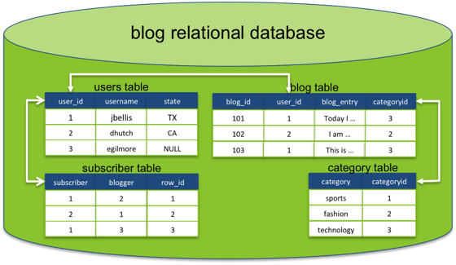
RDBMS Model of a Blog Application
People who run blogs
Lists of blogs on the internet
People who subscribe to blogs
Types of blogs
Since the data is so interconnected, querying will require joins which can impact performance
Notes:
As an example we will see how the data of a blog can be modelled using a RDBMS and how this model can be adapted for a columnar database.
As an exercise try to model this relational database blog using a columnar data model.

Slide 9
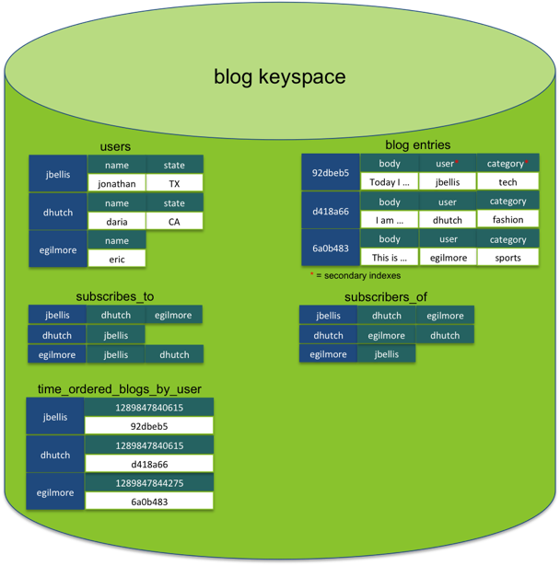
Columnar Model of a Blog Application
Storing the data in a columnar format reduces redundancies
Querying can be made more efficient without needing to join on ID fields
Notes:
In this example the subscriber table is split in two tables: in one we have immediate access to who a user is following and in the other to who are the followers of a user.
The take home message is to model the data according to the query.
Note the denormalization and the repetition of information. In this case, the logic for guaranteeing that the data are consistent, will be in the application and not in the database, as it would happen in a RDBMS.

Slide 10
Benefits
Performance
Operations can run in parallel in the distributed environment and minimum latency
Columnar operations such as MIN, MAX, SUM, etc. can be performed quickly in a single step
All data does not need to be read in; specific columns can be read efficiently based on operations
Compression
Same data type in each file - uniformity
Self-indexing; uses up less space to store
Can be scaled horizontally and can store petabytes worth of data
Notes:
Due to the flexibility of the schema and lack of constrains within the data model the NoSQL database have a very high horizontal scalability that allows to store up to Petabytes of data while still maintaining very low access latencies.

Slide 11
Comparison: Cassandra vs. Hadoop
Cassandra NoSQL data storage system known for fault tolerance and consistent performance Deployment good for geographically distributed data centers Ideal for large amounts of interactions (transactions), such as backend for online systems. Example use case: Netflix Highly structured data architecture | Hadoop Ecosystem of big data architecture tools. Has its own data storage systems (HBase and Hive) Deployment good for single location or a set of geographic co-locations Ideal for large amounts of streaming/batch data. Example use case: Etsy Architecture can accept both structured and semi-structured data
Hadoop can run on top of Cassandra to provide enhanced analytical capabilities that Cassandra does not have on its own

Slide 12

Major Vendors:
Cassandra

Slide 13
Cassandra - Outline
History and evolution of the vendor technology
Overview of technology
Data Model
Architecture
Industry Use Cases
Accenture Use Cases
Code and deployment information
Notes:
Narrative:

Slide 14
History of Technology
Facebook starts to develop Cassandra in order to be able to power their inbox search
Datastax (principal Cassandra distributor) is founded
Cassandra 2.0 is released
07
10
11
13
Cassandra graduates as top level Apache Project
Cassandra 1.0 is released

Slide 15

Overview of technology
Cassandra was developed based on two papers:
Amazon’s Dynamo [1] for the distribution and replication model
Google’s Big Table[2] for the data model
Cassandra within the CAP theorem
Cassandra offers a tunable consistency model that balances consistency with latency
Partitioning
Consistency
Availability
[1] http://www.allthingsdistributed.com/files/amazon-dynamo-sosp2007.pdf
[2] http://static.googleusercontent.com/media/research.google.com/en//archive/bigtable-osdi06.pdf
Notes:
Cassandra was build based on two main papers
Amazon Dynamo for the distribution and replication data mode in a ring fashion and
Google Big table for the data model and the concept of wide column databases.
Within the CAP theorem, Cassandra positions itself along the edge between consistency and availability. It is a Partitioned system where Consistency can be traded for Availability

Slide 16
CQL
Cassandra offers a SQL similar language called CQL to access the data. This was primarily meant for users that have more familiarity with relational technologies.
CQL offers constructs for inserting, altering, retrieving and deleting data.
CQL does not include the JOIN construct (the data has to be modeled in such a way that JOINs are not required).
Notes:
To access the data Cassandra offers a language similar to the SQL.
This language was mainly intended to try to reach the users with strong SQL backgrounds.
CQL allows to perform basic crud (create, remove, update, delete) operations while it does not allow to query over different tables by joining them.

Slide 17
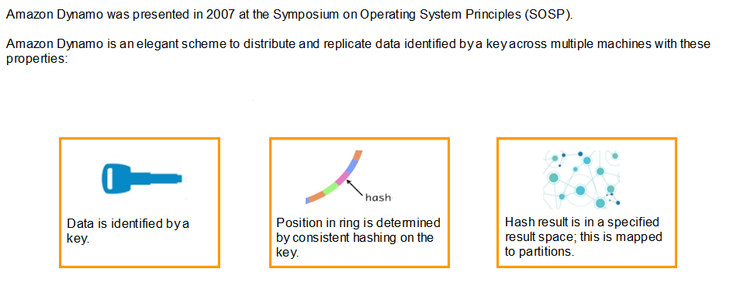
Data Model
Cassandra uses an elegant scheme to distribute and replicate data identified by a key across multiple machines with these properties
Each row of data is identified by a unique key.
Position in the ring is determined by consistent hashing on based on an Order Preserving Hash function.
Hash result is in a specified result space; this is mapped to partitions.
Notes:
The Cassandra data distribution follows Amazon’s dynamo paper. Every information is identified by a key which is distributed uniformly within a ring. The ring is divided into partitions where every partition is handled by a different set of machines.

Slide 18
Data Model
Key
Row
Column Family
Supercolumn 1
Supercolumn 2
Col A
Col B
Col A
Col C
Col D
Data
Data
Data
Data
Data
Graphical representation of the data, model. This model allows the data to have some levels of nested information.
Notes:
The following picture provides an idea about how the data are organized within Cassandra.
To every key is assigned row. A row will contain a very small set of column families and extremely large numbers of super-columns containing columns in turn.

Slide 19
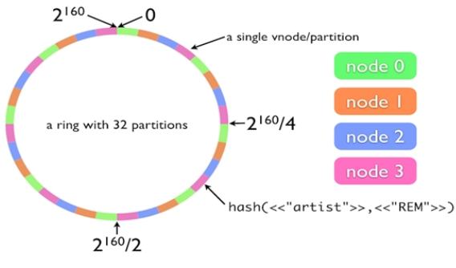
Architecture: Data Distribution and Replication
Every node has the same structure: master-less architecture
The system has near-linear scalability
Replication is built in, just take N adjacent partitions
Notes:
Cassandra has a master less architecture where every node has the structure. Every node knows what parts of the ring are stored in the partition that it is currently handling and it is able to redirect the incoming requests to other nodes if the key is not present within the assigned partition.
The data replication is built in, every information is repeated within the next n partitions.

Slide 20
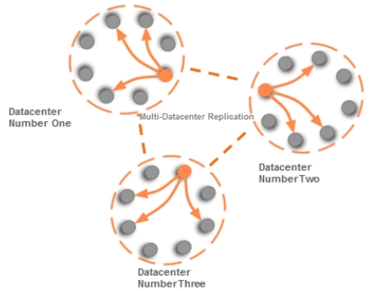
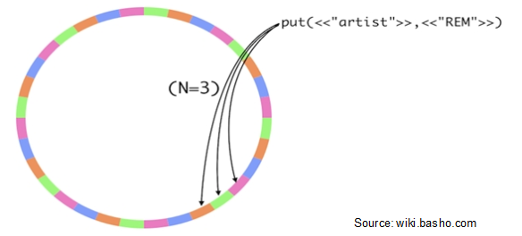
Architecture: Data Distribution and Replication
The replication across different data centers follows the same principle:
After the information is replicated in the next N adjacent partitions, it can be copied and replicated across several datacenters.
Notes:
To improve durability and resilience the data can be replicated also across different data centers. This also allows better protection against possible disasters.

Slide 21
Architecture: Data Distribution and Replication
Architecture built to be scalable - linearity of scale allows “n” times as many nodes to handle “n” times as many transactions
Emphasis is placed on partitioning from the CAP theorem. This allows ease of access to any node in a data center
Data is distributed automatically throughout all nodes in a cluster
With replication, data is stored redundantly across multiple nodes (no single point of failure)

Slide 22
Architecture: Data Distribution and Replication
Consistent Hashing: All nodes are assigned a range of hash keys, and each object is assigned a hash key. Allows for data distribution of nodes across cluster preserving order, even if nodes are scaled up
Internode Communications: Nodes use Gossip Protocol to exchange information. Failures can be detected quickly, while avoiding need to spend resourced on repairing any one node. Cassandra monitors failures using the mechanism of a family of failure detectors
Availability and Consistency: Replication ensures high availability. Eventual consistency is achieved during replication (all nodes have the latest data)
Incremental Scalability: Nodes can be incrementally added or dropped since caching is at the node level

Slide 23



Industry Use Case:
Problem: Provide Inbox Search feature to Facebook users on messages users send and receive.
Large amount of data to be stored
High rate of data growth
Data should be served within strict SLAs
The solution needs to scale incrementally and in a cost effective fashion
Traditional Data Storage
Systems
New Storage Solution was necessary: Cassandra
The aim was to design a solution that not only solved the Inbox Search problem but also provided a system as a storage infrastructure for many problems of the same nature.
Notes:
The amount of data to be stored, the rate of growth of the data and the requirement to serve it within strict SLAs made it very apparent that a new storage solution was absolutely essential.

Slide 24
Industry Use Case: – Cont.
Cassandra is a distributed storage system for managing structured data that is designed to scale to a very large size across many commodity servers.
Facebook implemented Cassandra on Inbox Search by allowing search on message terms and user recipient pairs:
Message Terms: Messages were indexed by users - each user ID became a key, and each message a supercolumn. The words of each message became columns within the supercolumn
User Recipient Pairs: User IDs were used as keys, and each recipient ID became a supercolumn. Each message sent to a recipient became columns within the supercolumn
Cassandra has achieved several goals – scalability, high performance, high availability and applicability.

Slide 25
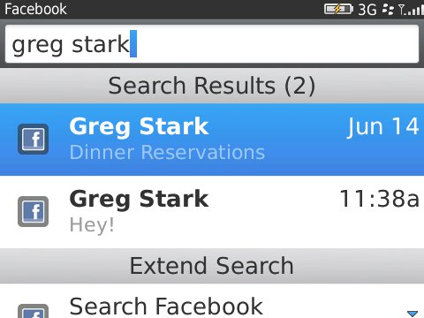
Industry Use Case: – Cont.
Cassandra was born at Facebook as a solution to their Inbox search problem in 2008 for 100 million users.
At the time of deployment, the system stored TB’s of indexes across a cluster of 600+ cores and 120+ TB of disk space.
Facebook abandoned Cassandra in late 2010 when they built Facebook Messaging platform on HBase due to eventual consistency in Cassandra.
In 2014, Facebook used Cassandra for Instragram switching from Redis, and claimed it cuts costs by 75%.

Slide 26
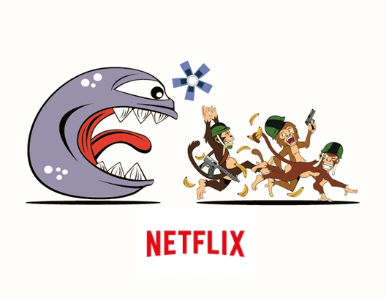
Industry Use Case:
Problem: Need storage solution for data in Amazon Web Services cloud that can handle large volume and is fault tolerant
Netflix moved into the AWS cloud in 2011 due to traditional Oracle database failure
Needed fast, fault tolerant system at Internet scale
Needed to find appropriate mechanisms to persist and query data within highlight distributed infrastructure
Needed system capable of large scale logging
SimpleDB, the database that Netflix used with AWS, had not kept pace with Netflix subscriber growth both in terms of SLA and cost effectiveness
Notes:
Netflix Queue: lets you keep and maintain a list of the movies & TV shows you want to watch on your devices and computers.
For every Netflix user, a list of ordered videos and other meta data related to when and where the video was added to their Queue is persisted in AWS Cloud, with SimpleDB as the source of truth. Data in SimpleDB are sharded across multiple domains (similar to RDBMS tables) for performance and scalability purposes. Queue data is used for both display purposes as well as to influence personalization ranking. There are in total of 150+ Million records in our data store, with a total size of 300GB. Back when Queue service was originally designed in 2009, SimpleDB was a good solution. However, since then, it has not kept pace with our subscriber growth both in terms of SLA and cost effectiveness.

Slide 27
Industry Use Case: - Cont.
Cassandra was chosen for the new data store on AWS:
High volume, low latency writes requirements for the Netflix queue
Netflix reads that are primarily accessed through key-value lookups
Every node is a coordinator as well as a data node (there are no master/slave relationships)
Open Source technology that is Java based
Cassandra Achieved:
High Data Consistency
High Reliability and Availability
No downtime for reads and writes
No degradation in performance of the existing application

Slide 28
Industry Use Case: - Cont.
Netflix is currently (as of July 2014) running Datastax Enterprise version 3.2.5 , with a cluster of 2700+ production across 90+ clusters.
It handles 95% of all database storage at Netflix, including but not limited to video metadata, subscriber information, and recommendations, managing 1 trillion+ operations a day.
In 2012, Netflix had 2 data centers: 1 in Ireland and 1 in US East Coast. The East Coast data center went down, thus causing Netflix to set up another data center in US West Coast, that caters to customers in the region, and can handle operations from the East Coast data center in case that fails.
In November 2011, NetFlix showed that Cassandra (C*) scales linearly as you add more nodes to a cluster achieving 1 Million writes per second, in a benchmarking test. In 2014, in a similar benchmarking test, they showed the systems sustains >1 million Writes/sec.

Slide 29

Accenture Use Case: Large US Bank
Problem: Need system that can process 200M messages a day from 3 global data centers and perform near real time analysis
Bank had multiple applications, with messages that required global logging and replication for analysis
Data was processed at 4 hour intervals, and current RDBMS could not maintain this
More immediate ingestion of data was needed
The bank’s existing RDBMS system was causing the bank to be vulnerable during planned outages, thus necessitating a new solution

Slide 30
Accenture Use Case: Large US Bank – Cont.
Cassandra was chosen for the new data store on AWS:
Accenture implemented a proof of concept using AWS public cloud architecture that allowed for globally distributed availability zones
Accenture provide new approaches to use Cassandra
Accenture provided technology leadership with installation, configuration, deployment and performance testing of the designed architecture
The bank experienced the following benefits with the implementation:
Better ingestion capabilities
Ease of scaling
Data replication
Reduction in maintenance costs

Slide 31
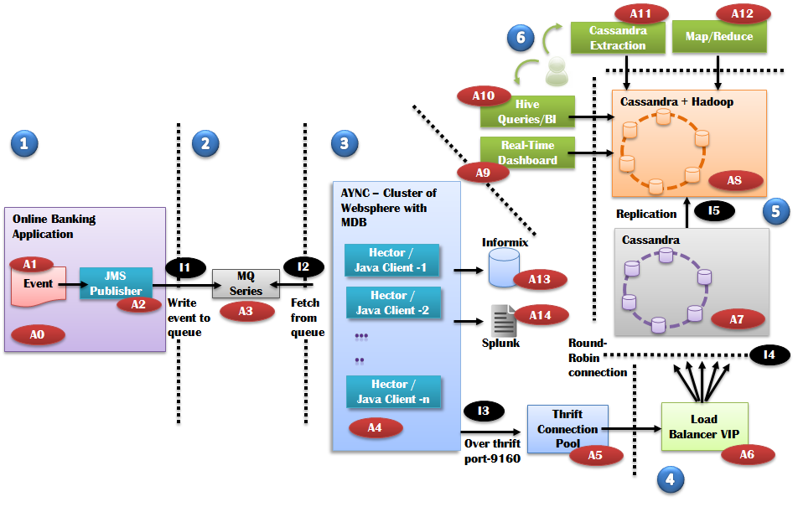
Accenture Use Case: Large US Bank – Cont.
Cassandra cluster operates across 2 global data centers and it supports high speed reading and writing of data
Technology can ingest 400M+ messages per day, exceeding the requirement by more than double
Capacity to handle 12 to 20X current load
6TB of data storage across 18 node cluster
Allows for near real-time data analysis

Slide 32

Accenture Use Case: Large Government Agency
Problem: Need system that can provide high mail visibility with large scalable storage and allow real time analysis
Agency suffered from poor system performance
Data not always available, thus not able to achieve 100% mail visibility goal
Existing system could not handle data volume or provide real time reporting
Infrastructure limitations caused inability to predict mail volumes
The existing Oracle solution could not actively monitor or report on mail performance, thus negatively impacting product offerings, customers, and service providers

Slide 33
Accenture Use Case: Large Government Agency– Cont.
Assessment of current ETL system yielded that it could not scale up. New offerings were assessed, with solution design of Cassandra and Hadoop hybrid with in-memory DB
Once implemented, the new approach will address:
Near real time data ingestion and processing for reporting
Prediction of mail volume to enhance routing
Better visibility into mail service performance
Improvement in customer revenue data
Low cost and can handle high data volume

Slide 34
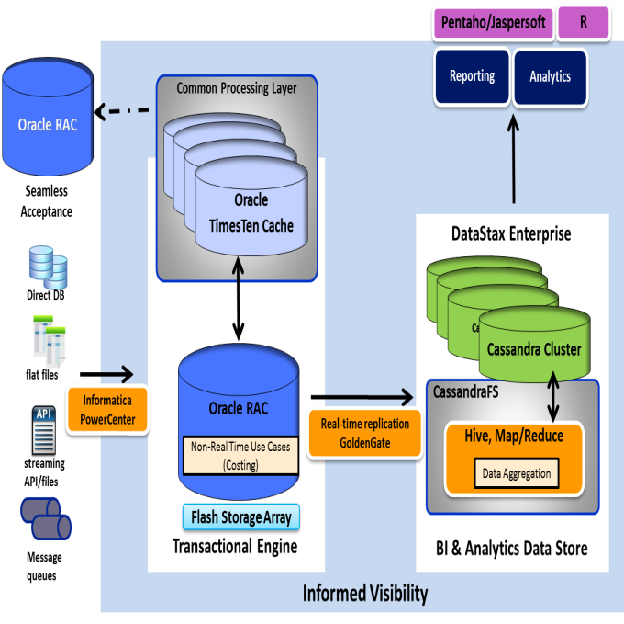
Accenture Use Case: Large Government Agency– Cont.
The technology will run on top of existing Oracle DB
It will scale to 100-140 TB
Solution handles 3.5M db writes/sec peak and 2.5 M db reads/sec peak in support of transactional use cases
Solution handles 2M db writes/sec peak and 2.25M db reads/sec peak for the reporting and analytical use cases

Slide 35



Cassandra Distributions
Open Source:
Apache Cassandra
Latest release 2.1.0 (released on 2014-09-11)
Binary tarballs, and Debian packages are available
http://cassandra.apache.org/download/
https://github.com/apache/cassandra
DataStax Community Edition (DSC)
Most stable & recommended release 2.0.10
Sandbox, Binary tarballs and installers for Linux, Windows & Mac OSX
http://planetcassandra.org/cassandra
Enterprise:
DataStax Enterprise (DSE)
Latest Stable release 4.5 (corresponding to Apache release 2.0.10)
www.datastax.com/download
The Apache Software Foundation
Notes:
NARRATION:

Slide 36
Cassandra Distributions Comparison
Feature | Open Source | DataStax Enterprise
Database Software
Data Platform | Latest Community Cassandra | Production-certified Cassandra
Core security features
Enterprise security features | No
In-Memory Feature | No
Built-in automatic management services | No
Integrated analytics | No
Integrated enterprise search | No
Workload/Workflow Isolation | No
Easy migration of RDBMS and log data | No
Certified Service Packs | No
Certified platform support | No
Management Software
OpsCenter | Basic functionality | Advanced Functionality
Services
Community Support
Datastax 24x7x365 Support | No
Quarterly Performance Reviews | No
Hot Fixes | No
Bug Escalation Privilege | No
Custom Builds | No | Option
EOL Support | No
Licensing | Free | Subscription
Source: DataStax
Notes:
Datastax is the only Cassandra provider for enterprises.
Differently from the Open source version Datastax Enterprise offers advanced tools for analytics and search, with a better support.

Slide 37
Key decision points for using this technology
Global distributed storage system
Low latency access to the data
Optimal for write intensive operations thanks to the relaxed consistency model
Data store + computing layer (Map Reduce, Spark)
Storage of large sparse tables
Flexible data model
Notes:
Cassandra is not a silver bullet and it has to be adopted for the correct use cases.

Slide 38
Scenarios NOT suitable for Cassandra
A lot of very complex queries
Big effort in maintaining denormalized tables
Data containing lots of relationships
Documents containing several levels of nested information
Small amounts of information
Very strict security requirements
Notes:
If it is used in scenarios that do not exploit the Cassandra strenghts, the results might not meet the expectations.

Slide 39
Resources
Apache Cassandra Project
http://cassandra.apache.org
Apache Cassandra Wiki
http://wiki.apache.org/cassandra
DataStax for Software Downloads, Documentation and Tutorials
http://www.datastax.com
http://www.datastax.com/documentation
Planet Cassandra
http://planetcassandra.org
Cassandra Support Forum
http://stackoverflow.com/questions/tagged/cassandra
Notes:
NARRATION:

Slide 40
Major Vendors:
HBase

Slide 41
Major Vendors - HBase
History and evolution of the vendor technology
Overview of technology
Data Model
Architecture
Industry Use Cases
Accenture Use Cases
Code and deployment information
Notes:
Narrative:

Slide 42
History of Technology
Powerset starts developing Hbase based on Google’s Big Table and Hadoop for natural language processing
Hypertable is started, it is a HBase clone written in C++
HBase 1.0
is released
06
08
10
15
NSA starts developing Accumulo, a HBase clone with enhanced security features
HBase graduates as top-level Apache project

Slide 43

Overview of technology
HBase was the original implementation for Hadoop of Google’s Big Table[1] for the data model
HBase within the CAP theorem
Since it is based on Hadoop HBase is a consistent database.
Partitioning
Consistency
Availability
[1] http://static.googleusercontent.com/media/research.google.com/en//archive/bigtable-osdi06.pdf
Notes:
Hbase is a technology based on the Hadoop platform and in particular on the HDFS. This means that the data will always be consistent at the cost of a reduced availability.

Slide 44
Data Model
Similar to Cassandra, HBase organizes data into tables. Each table contains multiple rows, and each row is identified by key/value pairs, where key is the column identifier, and value is the column content. Columns are grouped into column families. The below illustrates the data model:
Column Families
Row keys in table
CF1
CF2
Row Key
001
002
003
C1
YY
C2
JJ
LL
C3
PP
QQ
C4
UU
C5
MM
NN
Columns
Cell. Represented by set {row key, column key, timestamp}
Notes:
Table: HBase organizes data into tables. Table names are Strings and composed of characters that are safe for use in a file system path.
Row: Within a table, data is stored according to its row. Rows are identified uniquely by their row key. Row keys do not have a data type and are always treated as a byte[ ] (byte array). Rows are sorted by their key.
Column Family: Data within a row is grouped by column family. Column families also impact the physical arrangement of data stored in HBase. For this reason, they must be defined up front and are not easily modified. Every row in a table has the same column families. Column families are Strings and composed of characters that are safe for use in a file system path.
Column Qualifier: Data within a column family is addressed via its column qualifier, or simply, column. Column qualifiers need not be specified in advance. Column qualifiers need not be consistent between rows. Column qualifiers do not have a data type and are always treated as a byte[ ].
Cell: A combination of row key, column family, and column qualifier uniquely identifies a cell. The data stored in a cell is referred to as that cell’s value. Values also do not have a data type and are always treated as a byte[ ].
Timestamp: Values within a cell are versioned. Versions are identified by their version number, which by default is the timestamp of when the cell was written. If a timestamp is not specified during a write, the current timestamp is used. If the timestamp is not specified for a read, the latest one is returned. The number of cell value versions retained by HBase is configured for each column family. The default number of cell versions is three.

Slide 45
Architecture
HBase sits right on the DataNodes to provide data locality and thus needs direct alignment with HDFS. HDFS is used as data storage for HBase, with data captured in HFiles.
Zookeeeper maintains server state and monitors for failure
Client (HBase)
HBase Master
Backup Master
Intermediary between client and cluster. Performs admin operations, for example, creating regions and assigning regions to servers
Zookeeper Ensemble
Zookeeper
Node 1
YARN NodeManager
Zookeeper
HBase RegionServer
Manages reads and writes on regions, which are sorted key ranges of data rows stored together. Runs on HDFS DataNode
Zookeeper
HDFS NameNode
NameNode contains meta data information on HDFS files
Notes:
For data coordination, HBase uses Ensemble that is a Zookeeper cluster. Due to the nature of the underlying “voting” Zookeeper’s Atomic Broadcast (ZAB) protocol, the clusters are always deployed in uneven numbers. For small to medium deployments, it is typically three or five nodes. All parts of the cluster announce their existence in Zookeeper.
The HBase Master coordinates the data ownership of the various RegionServers and is a central entry point. It detects its cluster nodes through Zookeeper, similar to the HDFS Master. The HBase Master is a SPOF. Typically, to recover quickly in the event of failure, a Backup Master runs in standby to take over when needed. Zookeeper coordinates this built-in failover support.
The Node: Each node runs different services. At the bottom sits the HDFS NameNode that keeps its blocks of data on a disk and ensures that changes are replicated to respective slaves.
The HBase RegionServer reads and writes into the HDFS NameNode and is typically responsible for a chunk of data from one or multiple HBase tables. These chunks are always ordered. For instance, if you store Wikipedia, a RegionServer could be responsible for all articles starting with E, F and G. By accessing the HTTP interface of the HBase Master and the RegionServer, these splits can be easily seen and also reconfigured.
The YARN NodeManager brings jobs to local execution. In the case of a MapReduce job, the code is executed locally against the node‘s HBase RegionServer, which in turn uses the local HDFS data, enabling high performance. A working data locality interplays between HDFS NameNode, HBase RegionServer and YARN NodeManager and is the key to good HBase performance. In the case of rebalancing, performance deteriorates significantly.

Slide 46
HBase vs. Cassandra
Cassandra and HBase are data stores that provide basically the same core operations and have similar data models. However, there are several differences between the two technologies.
 | HBase | Cassandra
In short | Original open-source implementation of BigTable | Dynamo-based BigTable implementation
Scalability | Datacenter | Datacenter/Global
Replication | Master/Slave | Master/Master
Consistency | Consistent | Tunable
Interfaces | Java, Thrift | Java, Thrift
Why cool | Very large scale, integration in Hadoop (Map/Reduce) | Perfect for high write rates in tabular data, with some query ability
Full Hadoop ecosystem integration rounds off for Batch and OLTP features.
Consistency enables familiar programming and data modeling patterns.
Notes:
We can see that on the surface both data stores provide basically the same core operations and they both feature a similar data model. However, there are also large differences between the two technologies. Like HBase, Cassandra is an open-source implementation of BigTable and is scalable.
Cassandra always goes for availability in the CAP Theorem trade-off while HBase chooses consistency. Data replication and high availability follow the classic Master-slave strategy.
This provides the core benefit of a very familiar and trusted programming and data model. This can be especially useful when keeping relations synchronized manually, which almost all but the most trivial BigTable-based solutions have to do. At the same time, the Master/Slave strategy makes HBase very vulnerable to network partitions because parts of the data will be offline until the respective slave takes over. While Cassandra is available commercially with partial Hadoop integration in the DataStax distribution, HBase support can be procured from many different vendors.
Avro is a highly efficient data serialization format similar to JSON, but it is binary, has a basic schema and a low-latency remote procedure call (RPC) mechanism. Avro is taking over the role that Thrift used to have in HBase.
For more detailed information on Apache Avro, use the reference link on the page.

Slide 47

Industry Use Case:
Problem: Need to improve the search results by indexing more data and more history. Need ability to rescore and reclassify entire site inventory.
eBay is one of the biggest online marketplaces
It has 100+ millions active buyers and sellers, 200+ millions items in more than 50,000 categories
9PB of data have to be indexed in order to be quickly retrieved by the internal Search Engine.
The previous system, Galileo, was unable to keep up with ranking items on a large number of factors, and perform search term matching beyond the title.

Slide 48
Industry Use Case: - Cont.
Hadoop + HBase were the chosen technology for creating such indexes:
Entire site inventory stored in HBase
Indexes are built via MapReduce jobs and stored in HDFS
Entire site inventory is built in hours
Near real time updates
Row key bit reversal of document id: better randomness and distribution than md5
Full table scan every couple of hours
HBase achieved:
Increased control over the whole inventory
More flexibility in customizing indices
Reduced time to market

Slide 49
Industry Use Case: - Cont.
As of 2012, HBase stores 15TB of data. It is organized into 3 major tables
2 billion+ daily page views are served with this technology
The entire inventory is stored on HBase, supporting 200 million+ daily queries

Slide 50

Accenture Use Case: Large Oil and Gas Company
Problem: Need a short term remedy to the poor performing legacy system. Design and deploy a solution for processing SCADA data efficiently
Company oversaw 40K+ active wells across North America
SCADA data from wells needed to be processed in near real time for operations and efficiency
Increase in well and data volume necessitation a need for a newer big data solution
The legacy PostgreSQL solution could not cope with the increasing scale of data, and Accenture was called in to provide guidance on replacement

Slide 51
Accenture Use Case: Large Oil and Gas Company– Cont.
A Hadoop framework was chosen, with HBase providing data storage
A modest sized (~100TB) HBase platform, which focuses on real time processing of SCADA data
Hive based analytics use cases, which utilizes SCADA data
Guidance in the implementation of a large scale ( ~1.6PB ) Hadoop data reservoir platform
The company experienced the following benefits with the implementation:
The legacy SCADA processing framework (PostgreSQL) was optimized to meet the immediate challenges of scale
SLAs for SCADA data streams were improved, which in turn increased well operational efficiency and reduced well operational costs
Received guidance in capacity planning, hardware selection, real time analytics use cases, amongst others

Slide 52
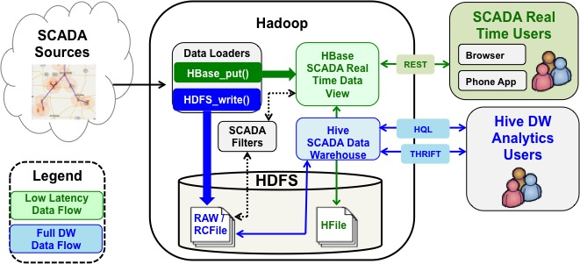
Accenture Use Case: Large Oil and Gas Company– Cont.
The HBase platform enables increase in SCADA data scope, scale, and resolution.
It ingests ~680MB/5min
Operational efficiencies achieved - 50% reduction in well downtime, in-line with corporate targets

Slide 53
Cost of vendor technology
HBase code base is freely distributed under the apache license
Included in all major Hadoop distributions
There are several implementations using the same APIs:
Hypertable (open source implementation in C++)
MapR-DB (proprietary implementation in C++)

Slide 54
Key decision points for using this technology
Storage of large sparse tables
Integration with Hadoop environment: availability of lots of tools for managing the data
Data Import and Ingestion
Advanced Analytics
SQL Layers
Consistency over Availability
Flexible data model
Very Low read latency

Slide 55
Scenarios NOT suitable for HBase
Need to scale to global scale
A lot of very complex queries
Big effort in maintaining denormalized tables
Data containing lots of relationships
Documents containing several levels of nested information
Small amounts of information
Very strict security requirements (alternatives like Accumulo might offer a valid alternative)

Slide 56
Lab: Columnar Databases

Slide 57
Cassandra Hands on Lab Exercise
A lab exercise (Intro to NoSQL Lab 3 – Cassandra) is created to give you hands on experience and evaluate your understanding of Cassandra
In this exercise you will imports posts and responses from static feeds obtained from StackExchange. Since the data in Cassandra is modeled to optimize reads we have picked some use cases to display data.
A Node.js application is used to display data and demonstrates the tight coupling between the application and the data model

Slide 58
Cassandra Hands on Lab Exercise
The exercise walks you through
Installing Cassandra and starting the related services.
Defining the data model then extending it to add new columns.
Node is used to load posts, responses and users into Cassandra.
The node application helps students inspect the data
We demonstrate how the data model allows for idempotent data operations within the context.
Students are challenged with a few tasks to demonstrate their understanding on the subject in the cqlsh shell (client)
Students are expected to create screenshots of their queries and results

